Slide 1


Slide 2
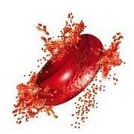
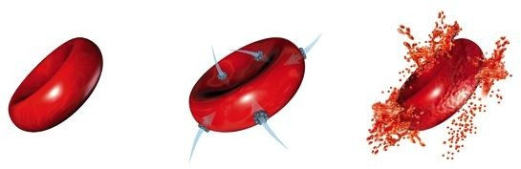
Anemia By
Eman Fathala Gad .
*Assistant Prof. of Pediatrics – Assiut University

Slide 3
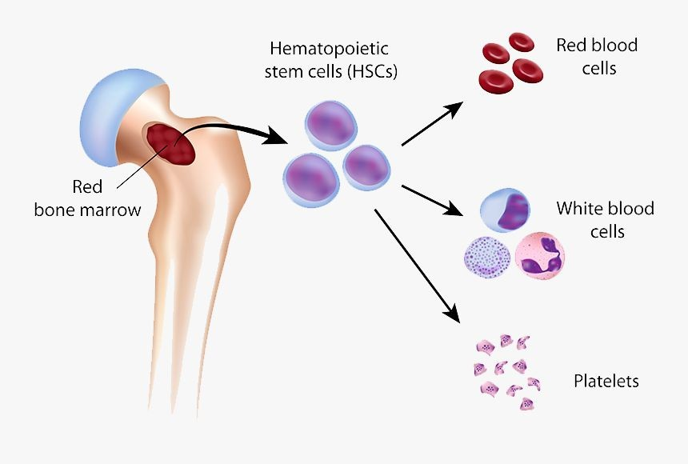

Slide 4
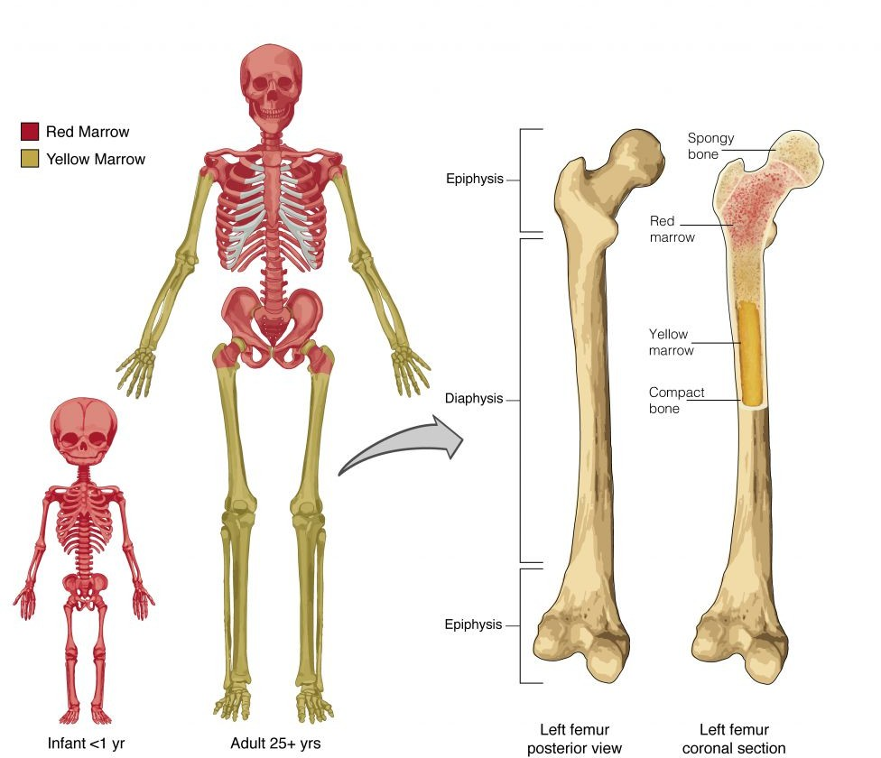

Slide 5
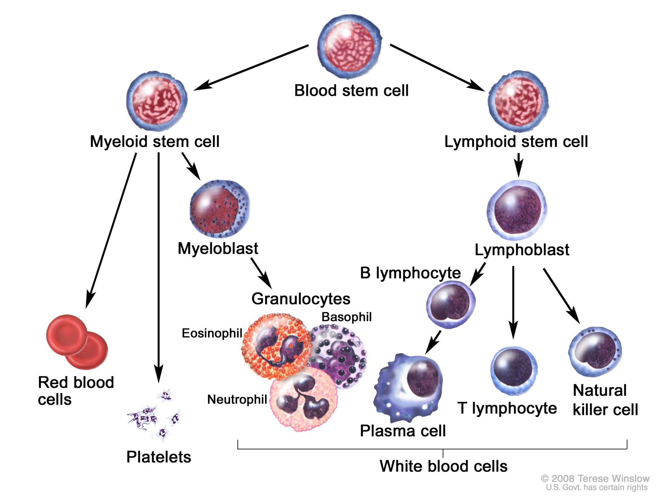

Slide 6
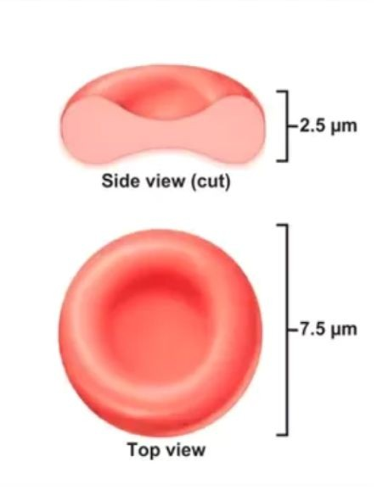
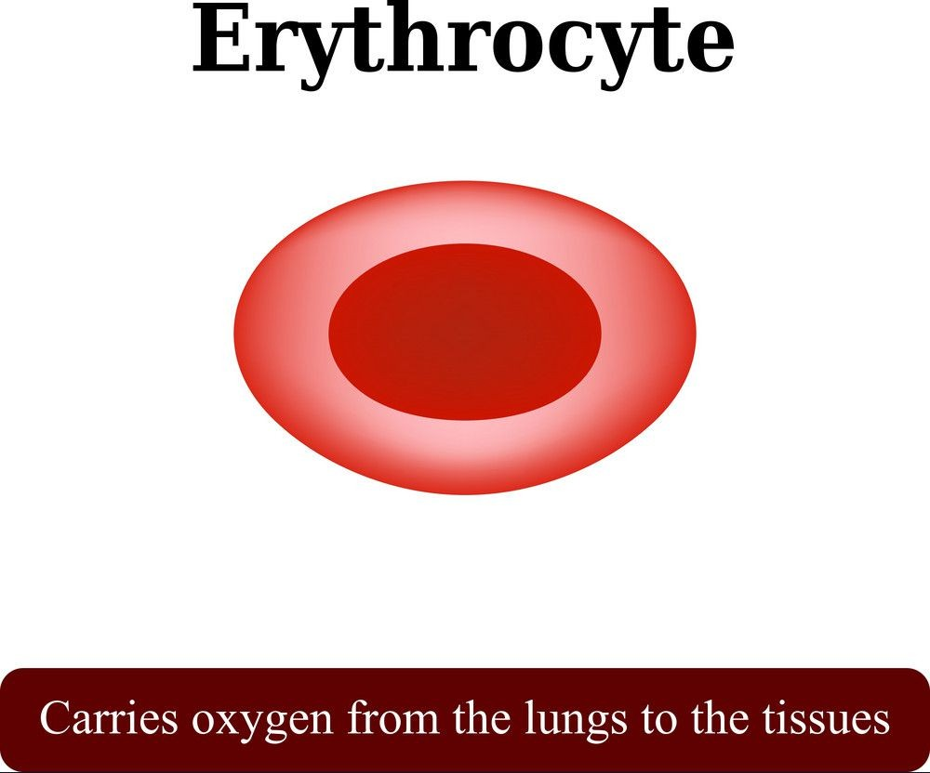
84% of the cells in the human body are red blood cells
Approximately 2.4 million new erythrocytes are produced per second in human adults

Slide 7
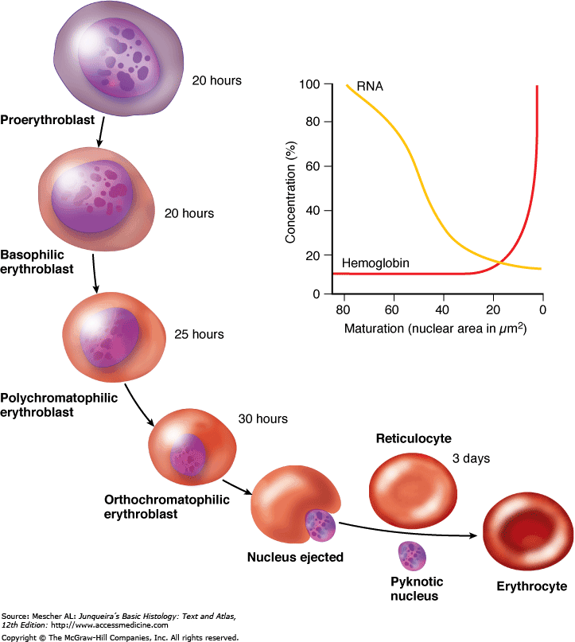

Slide 8
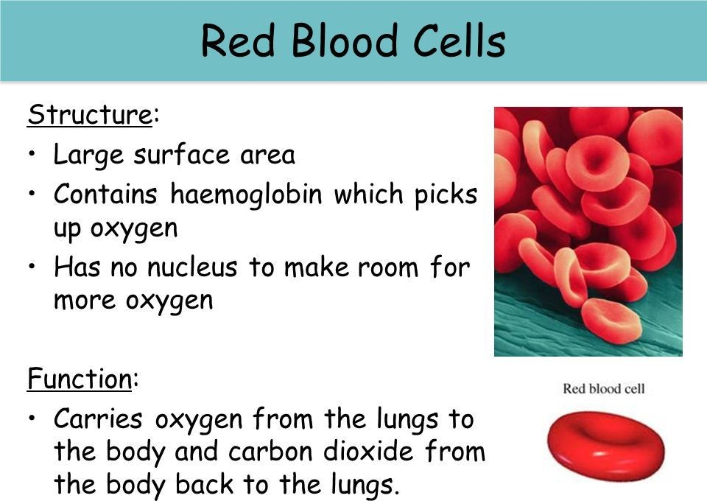

Slide 9
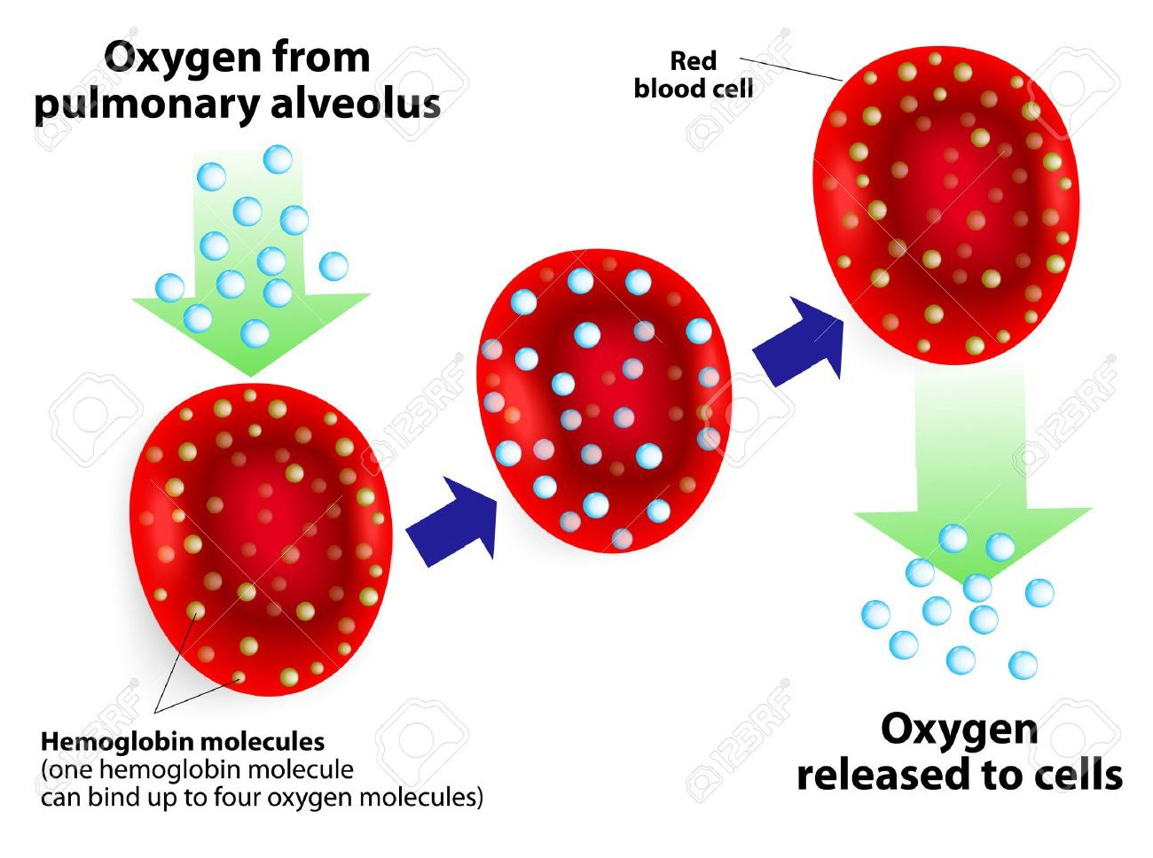

Slide 10
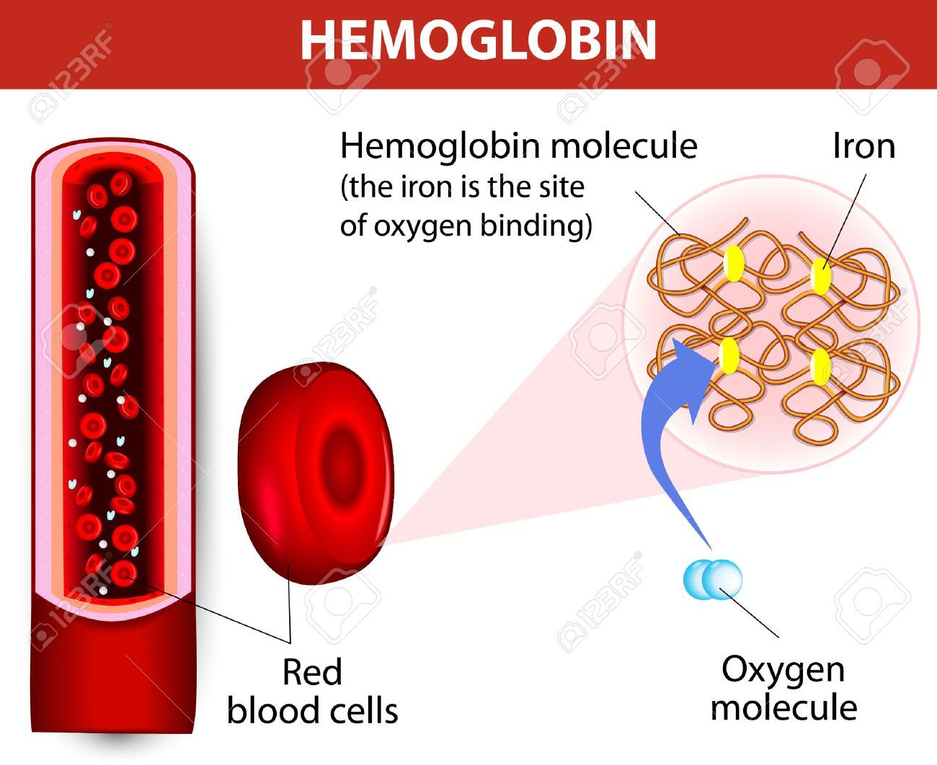

Slide 11
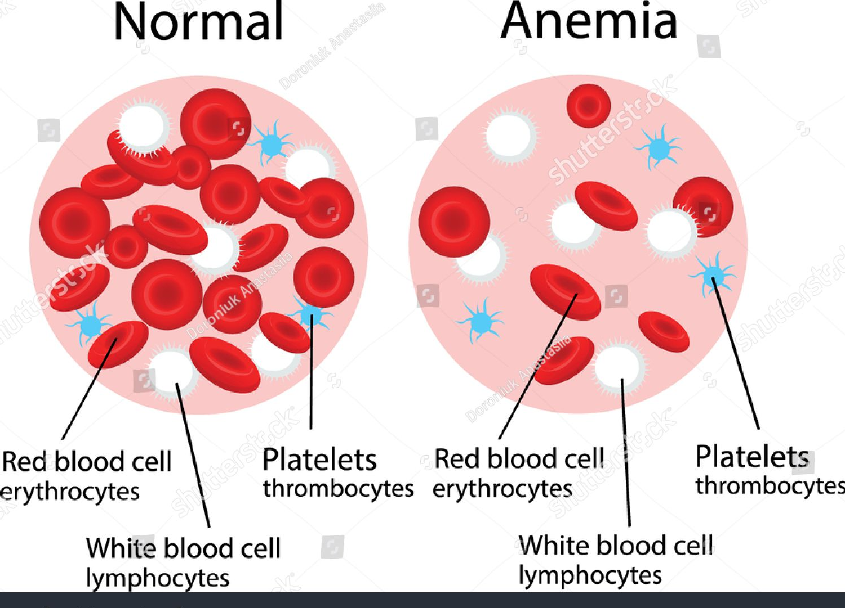

Slide 12
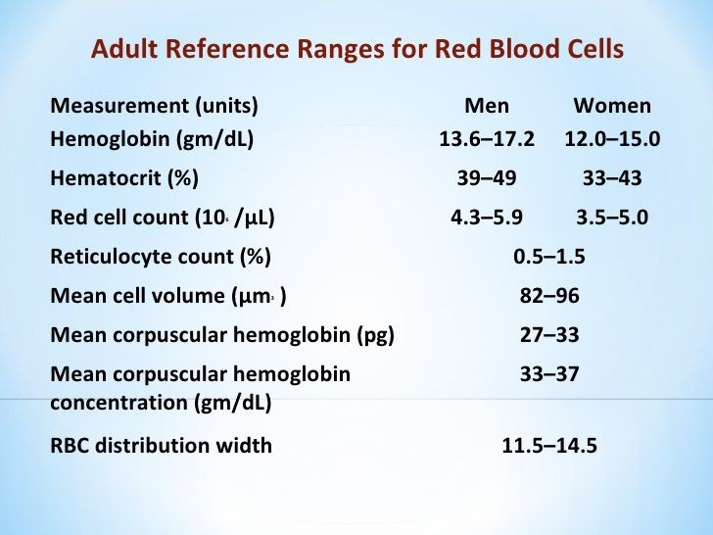

Slide 13
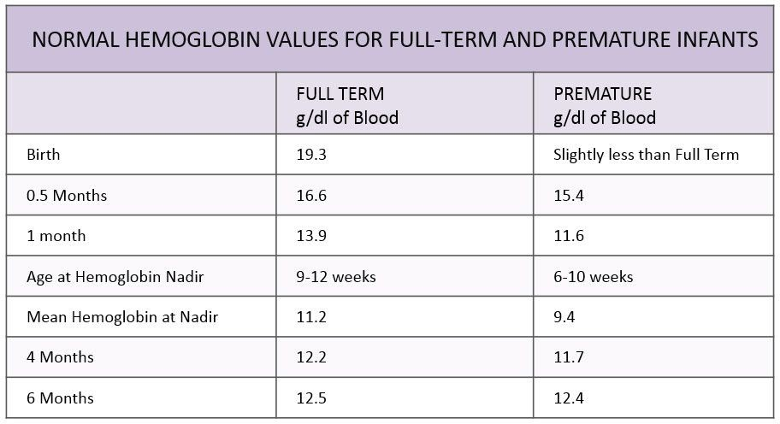

Slide 14
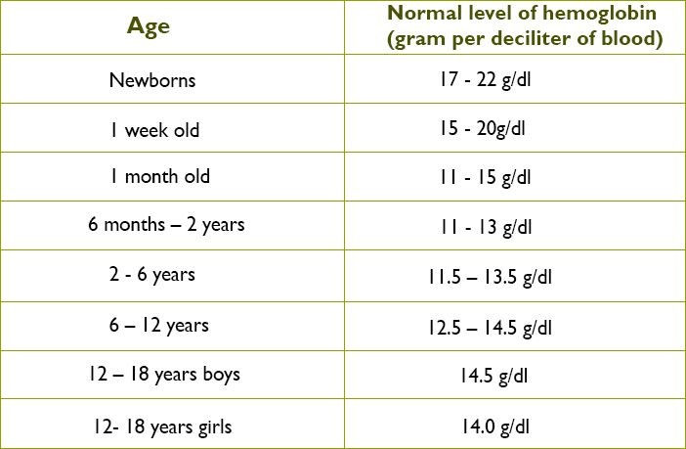

Slide 15
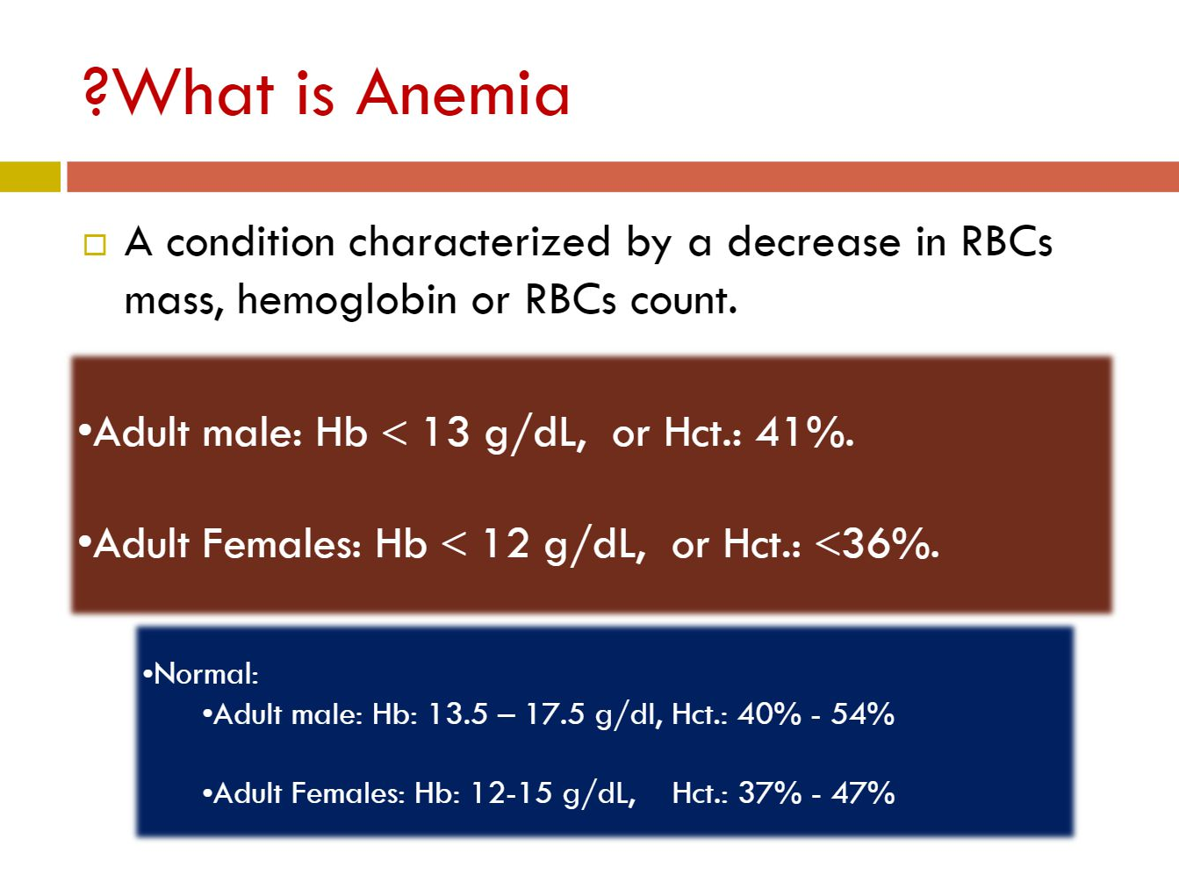

Slide 16
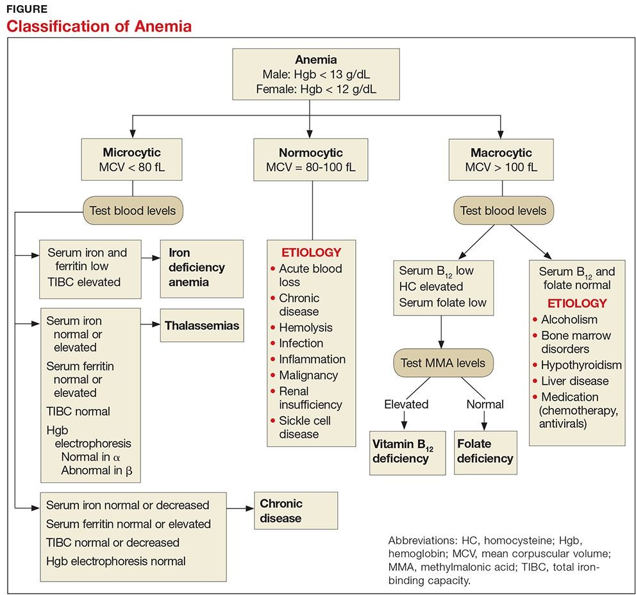

Slide 17
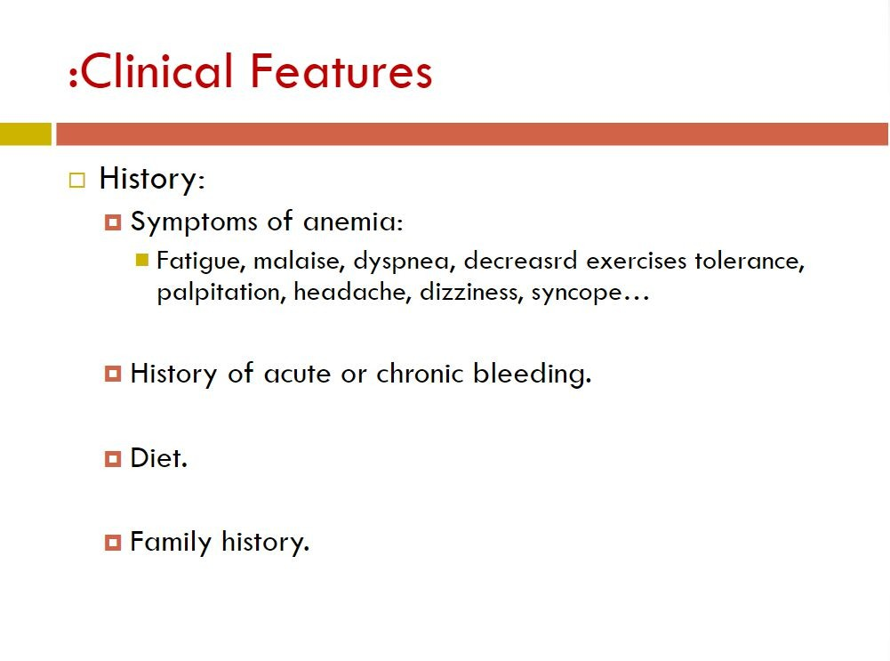

Slide 18
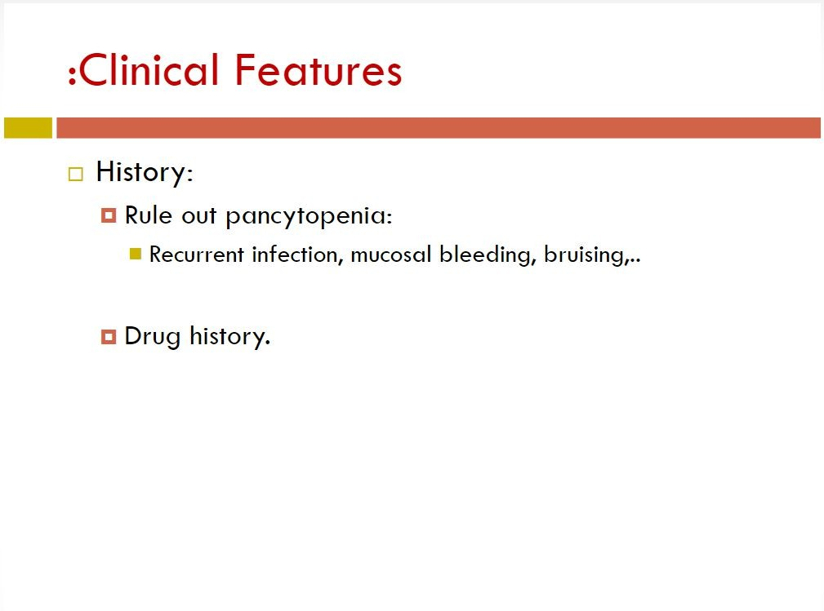

Slide 19
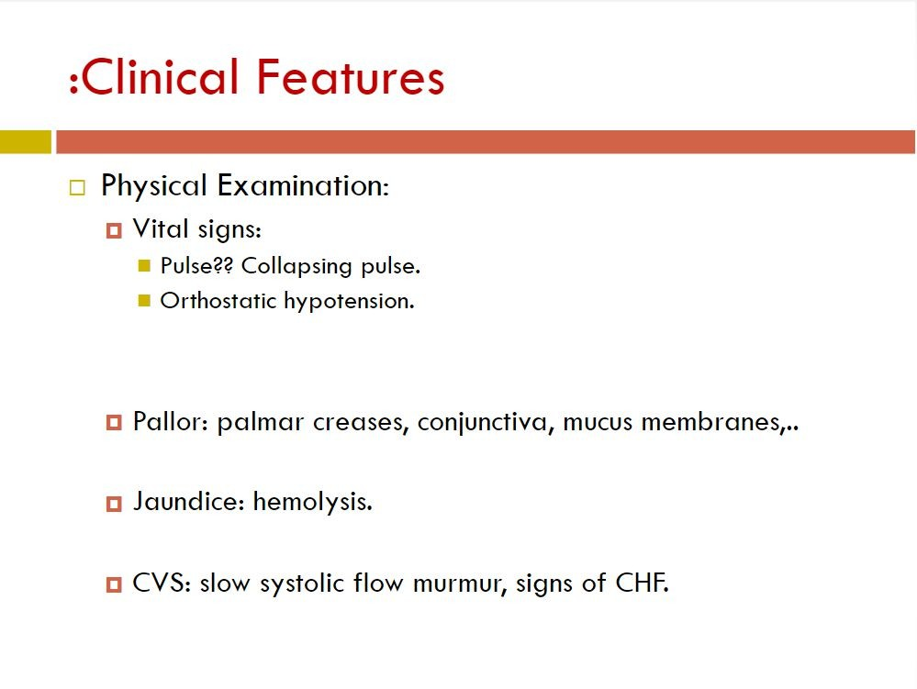

Slide 20
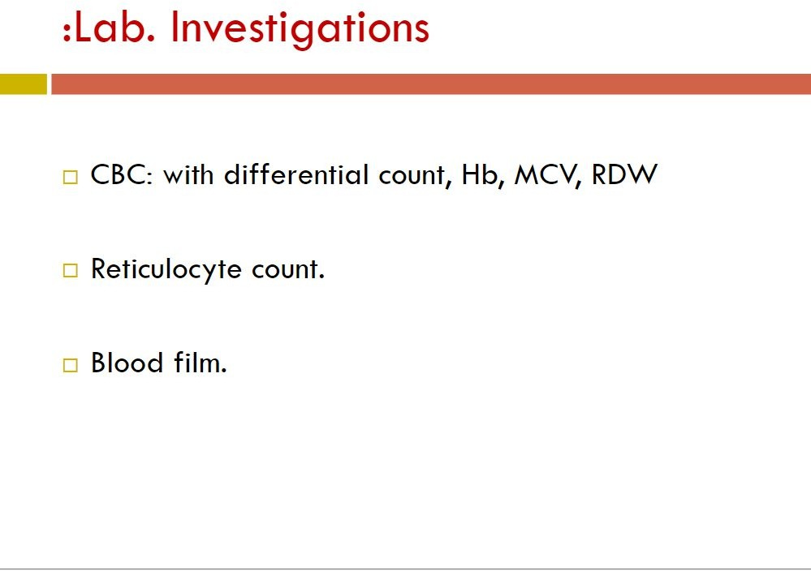

Slide 21
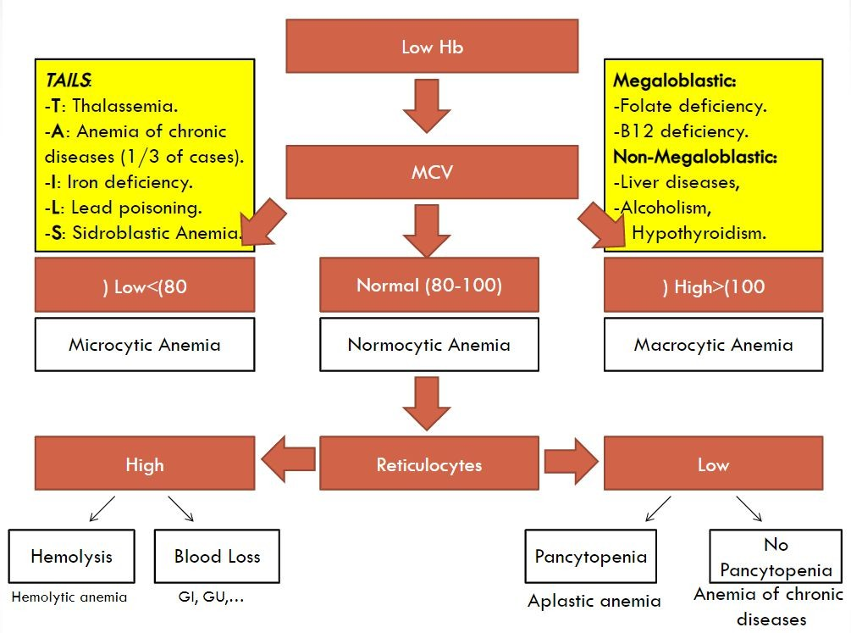
Low (<80)

Slide 22
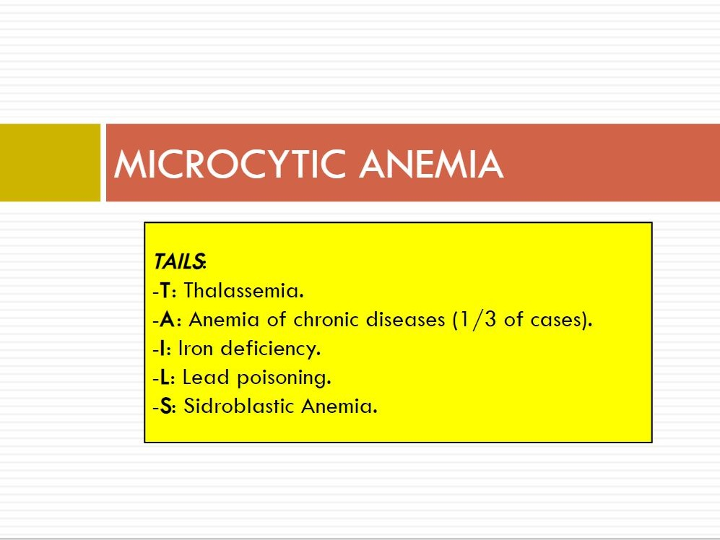

Slide 23
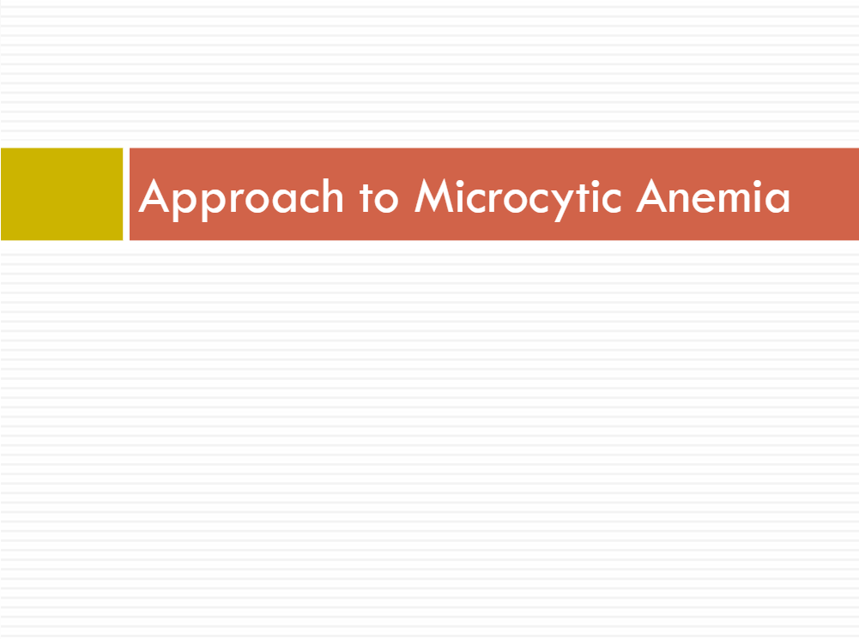
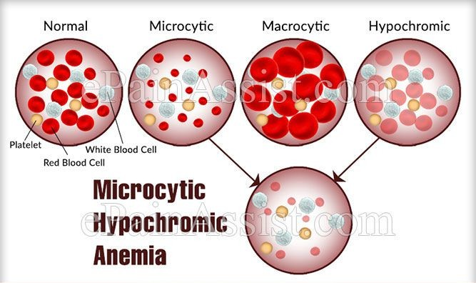

Slide 24
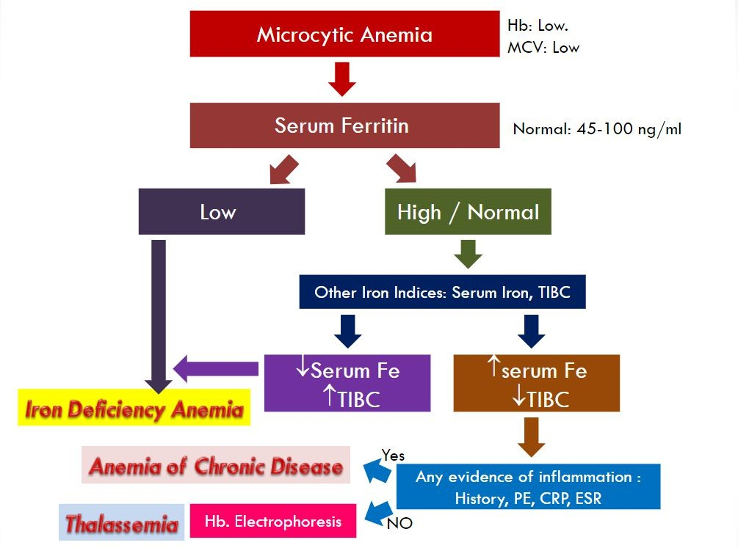

Slide 25
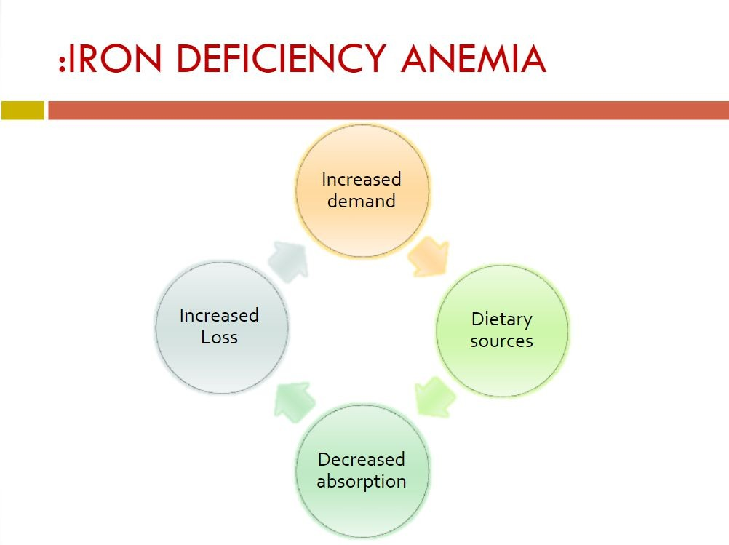

Slide 26
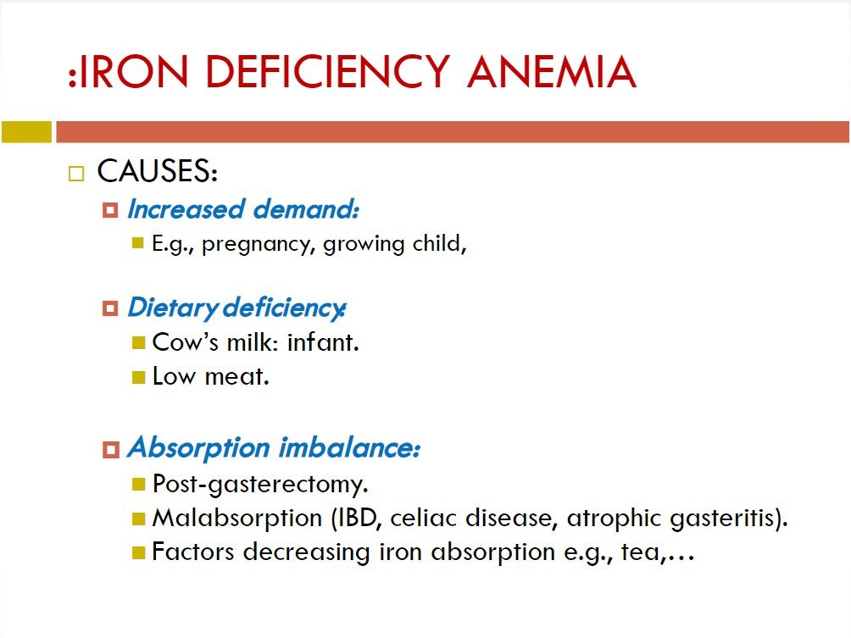

Slide 27
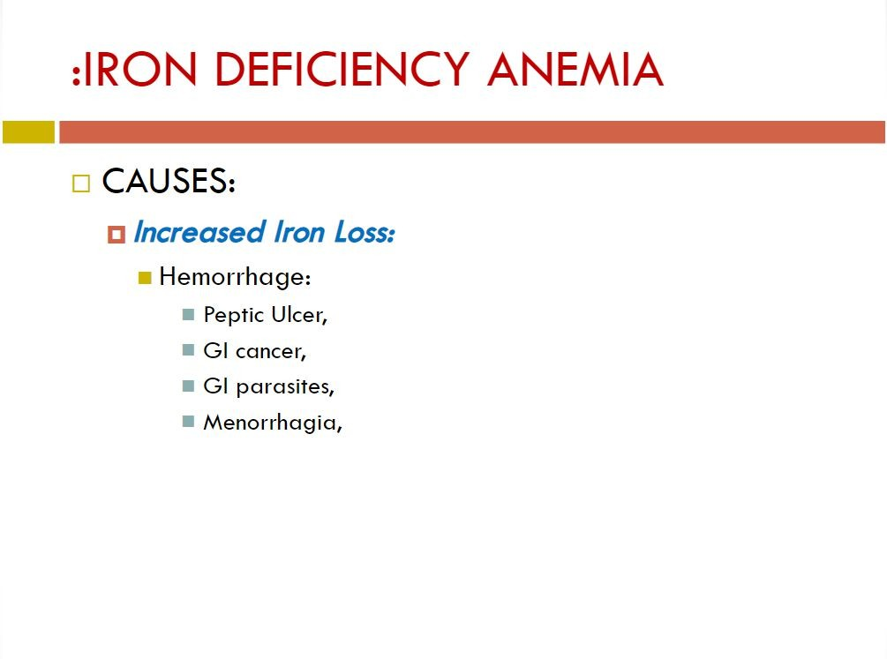

Slide 28
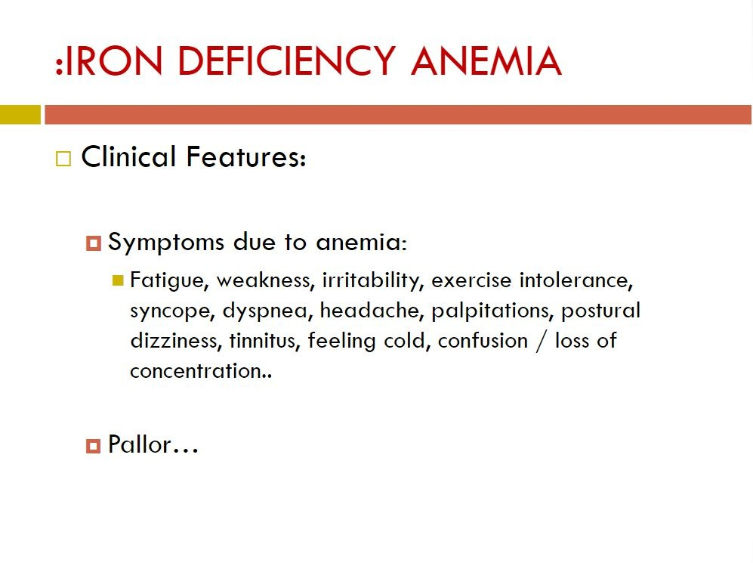

Slide 29
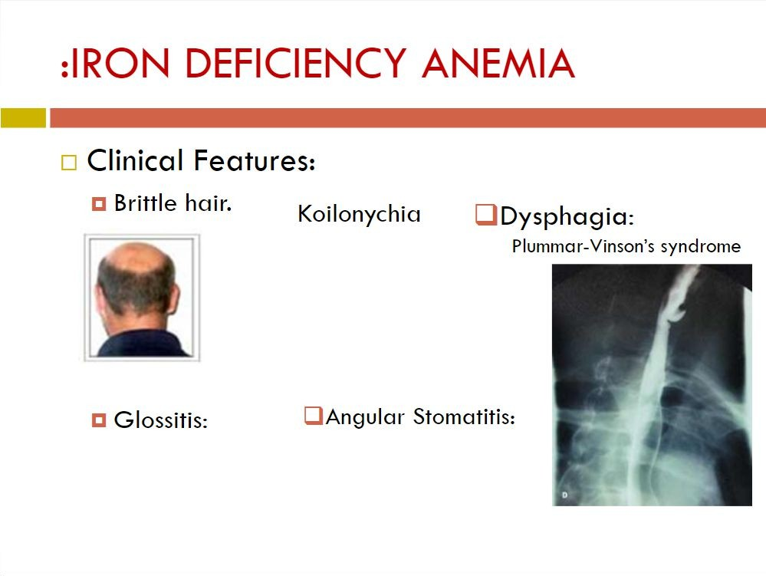
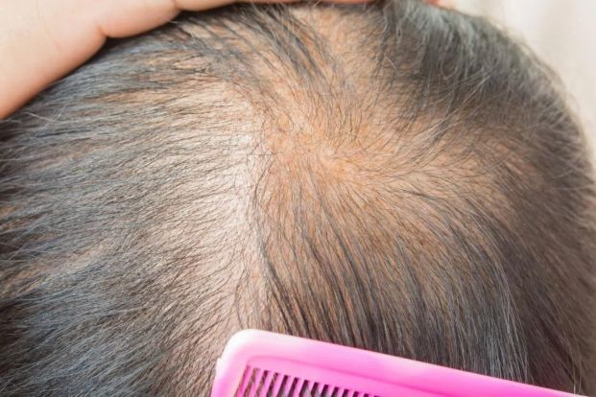
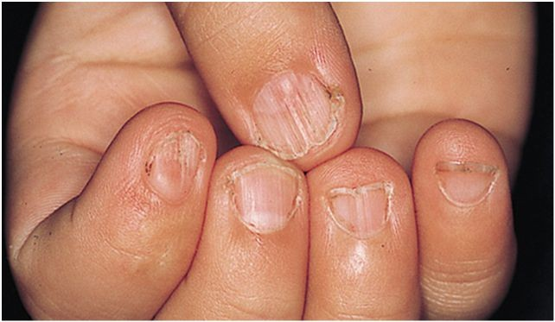
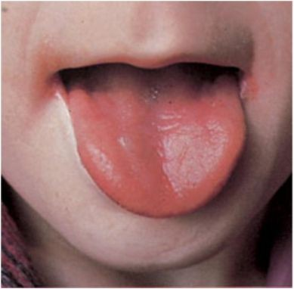
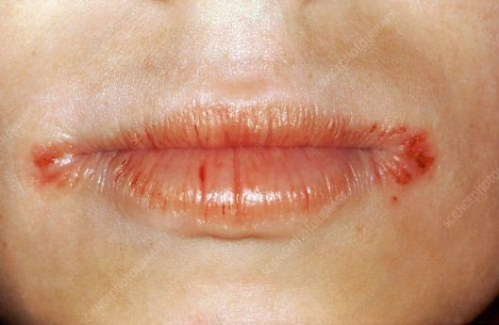

Slide 30
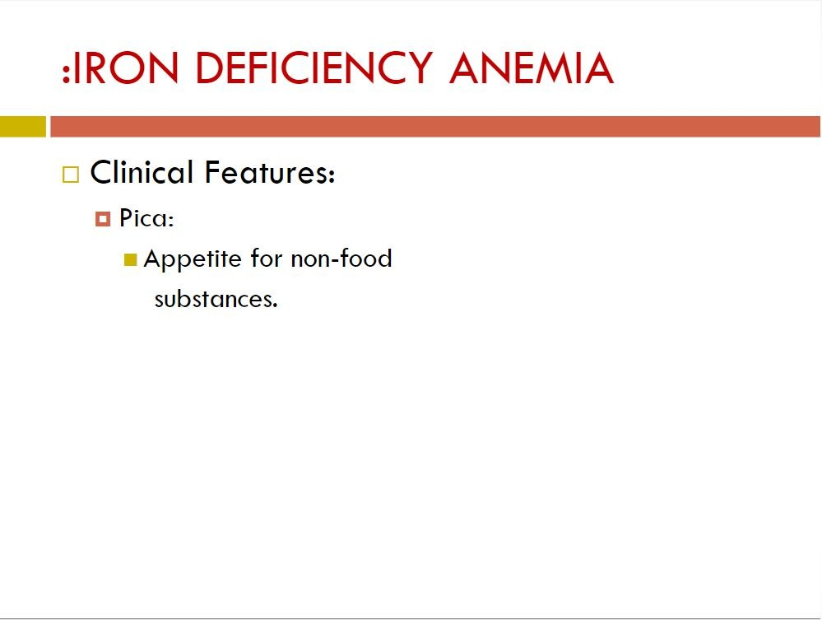
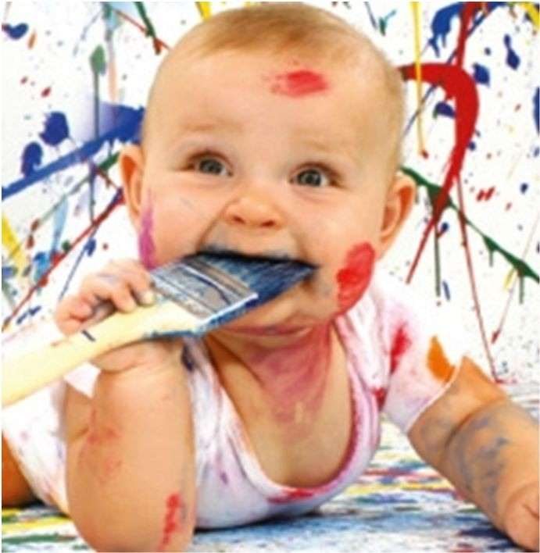
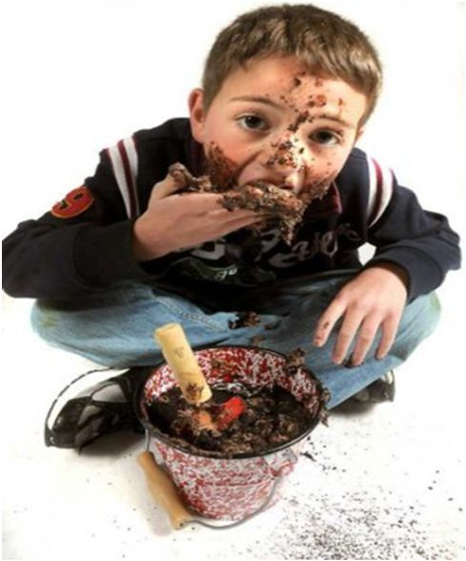
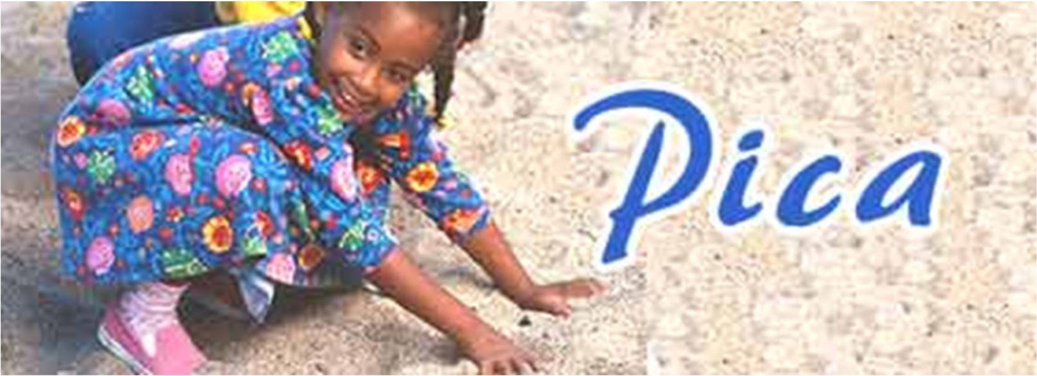

Slide 31
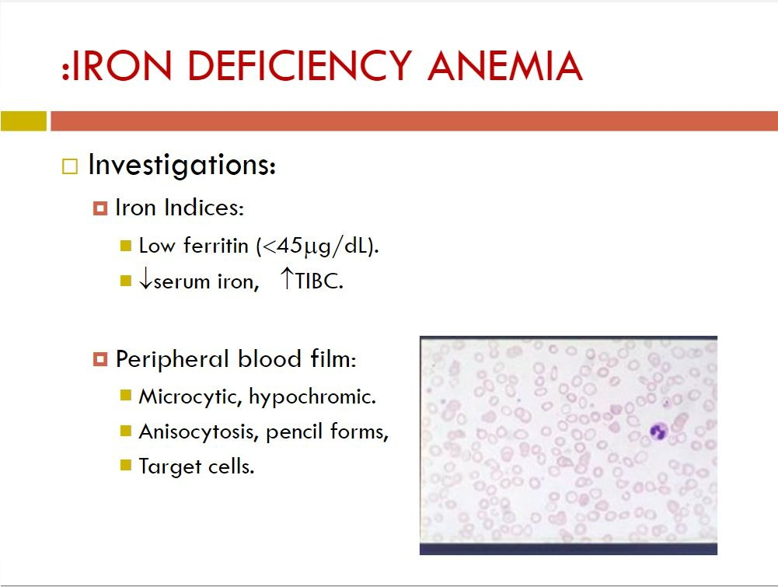

Slide 32
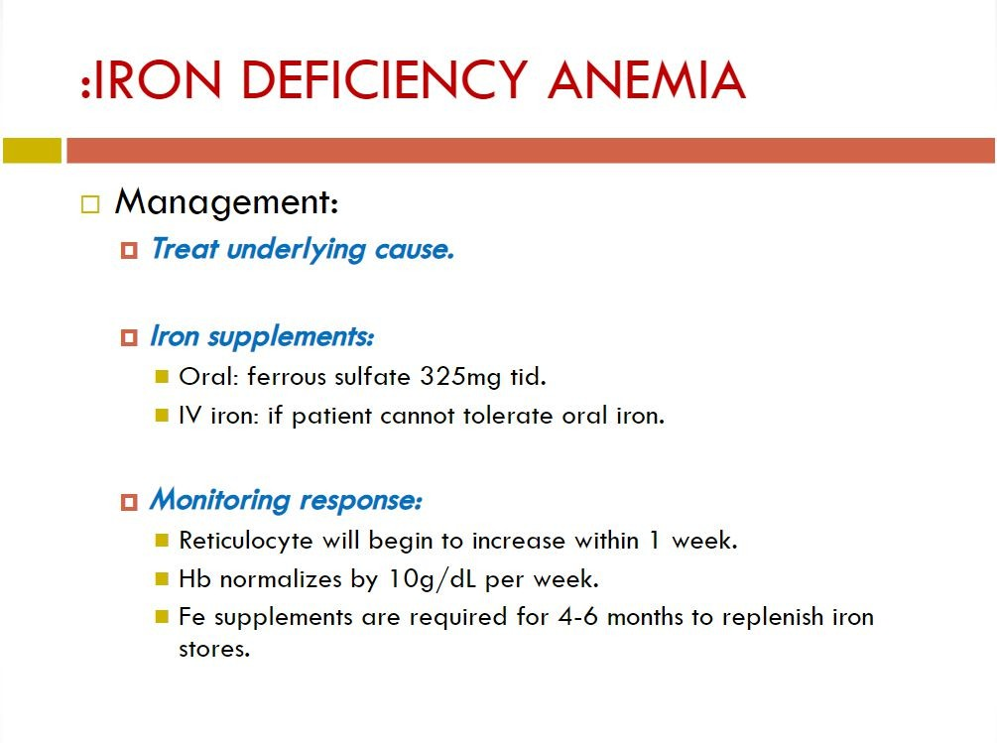
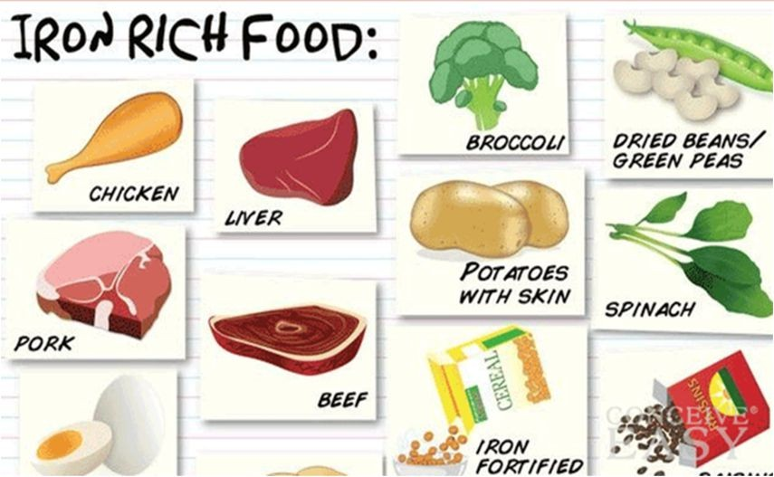

Slide 33

:Prevention of Iron Deficiency Anemia
Breastfeeding should be encouraged with the addition of supplemental iron at 4 mo. of age (12mg daily).
Infants who are not breastfed should only receive iron-fortified formula (12 mg of iron per liter) for the first year, and thereafter cow’s milk should be limited to <20-24 oz daily.

Slide 34
:Prevention of Iron Deficiency Anemia
During the first 2 years of life to ensure healthy growth and development, optimal infant and young child feeding practices include:
Exclusive breastfeeding* up to 6 months of age
Introduction of foods to complement the nutrients in breast milk at 6 months of age
Continuation of breastfeeding for 2 years.

Slide 35
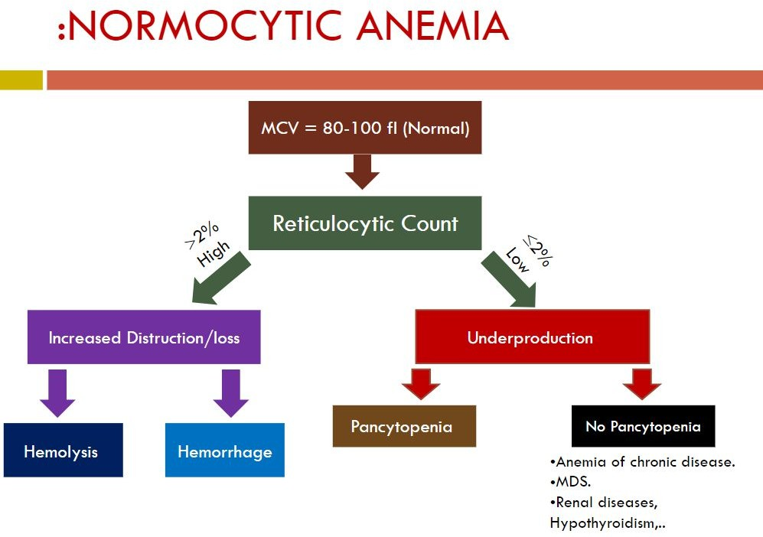

Slide 36
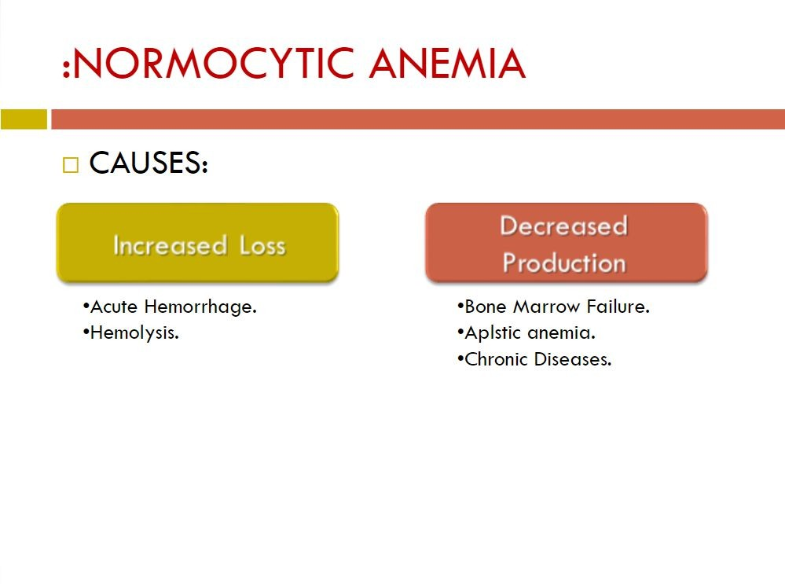
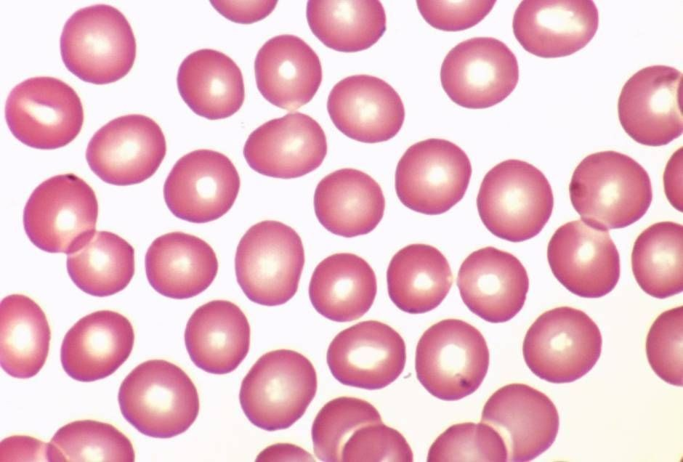

Slide 37
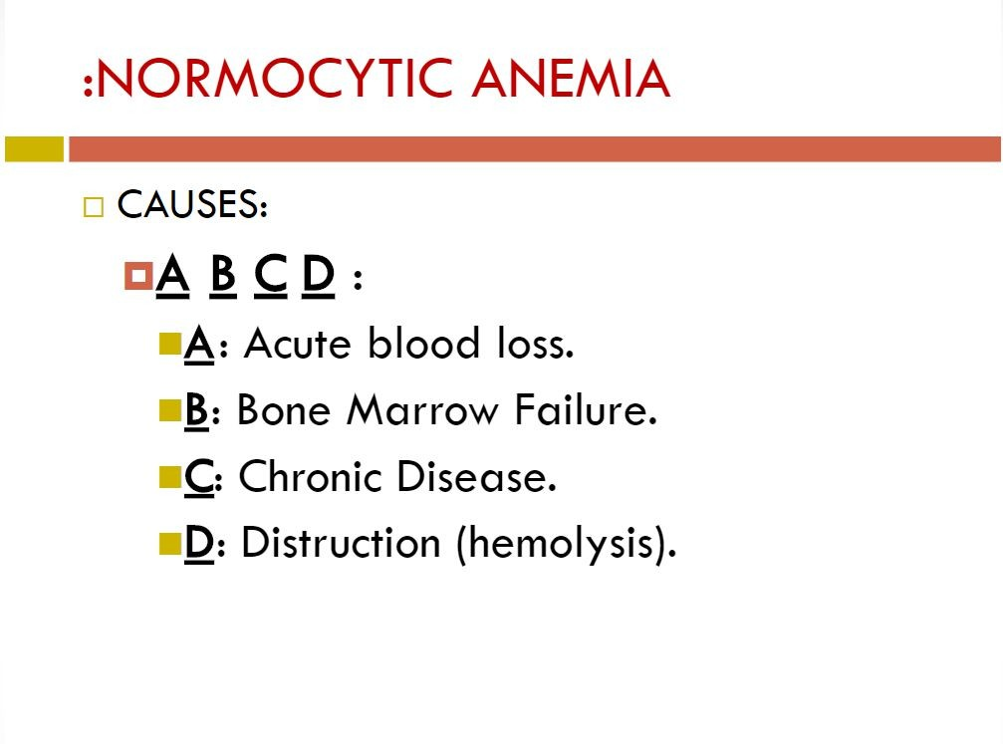

Slide 38
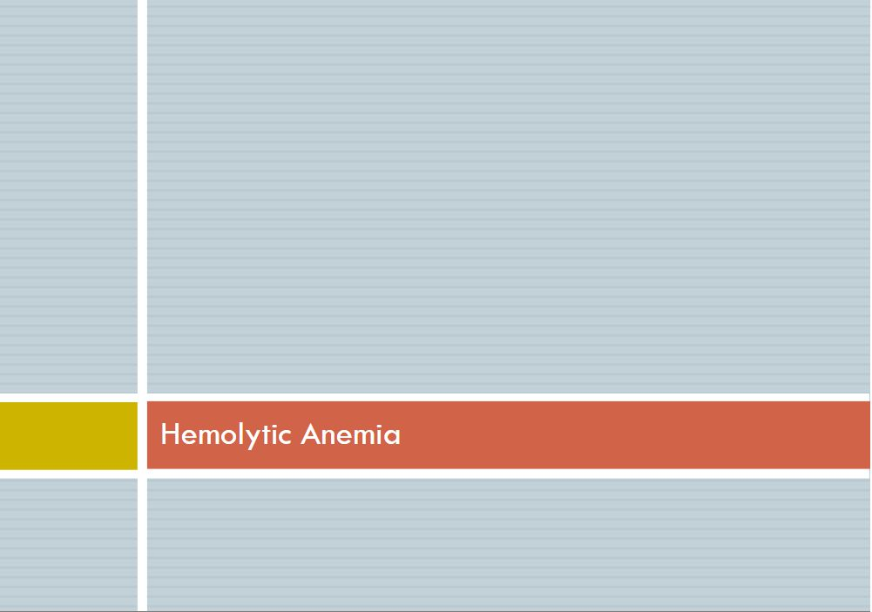
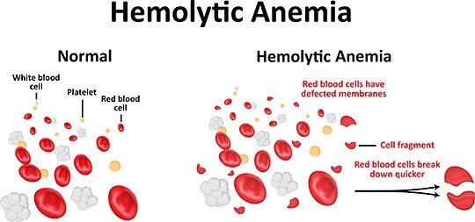

Slide 39
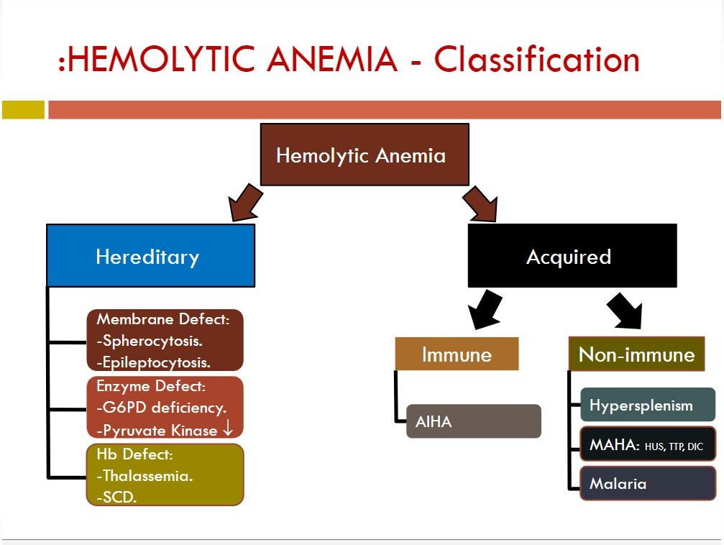

Slide 40
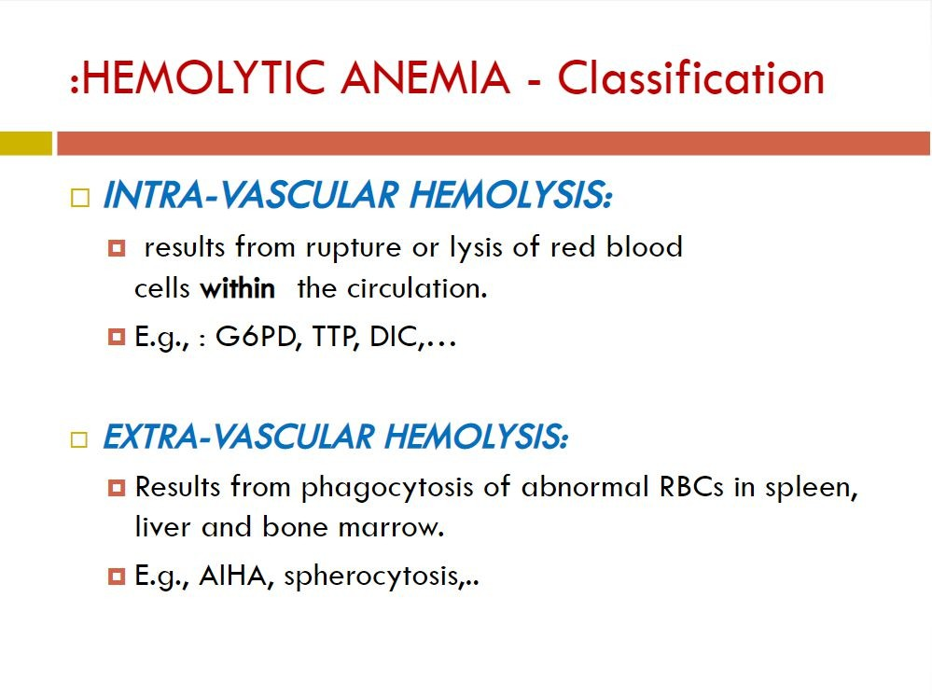

Slide 41





Slide 42


Slide 43


Slide 44


Slide 45


Slide 46


Slide 47


Slide 48


Slide 49



Slide 50


Slide 51



Slide 52



Slide 53


Slide 54



Slide 55


Slide 56



Slide 57

α Thalassemia
Predominant cause of alpha thalassemias is large number of gene deletions in the α-globin genes.
There are four clinical syndromes present in alpha thalassemia:
♫ Silent Carrier State
♫ Alpha Thalassemia Trait (Alpha Thalassemia Minor)
♫ Hemoglobin H Disease
♫ Bart's Hydrops Fetalis Syndrome

Slide 58


Slide 59


Slide 60
Types of βThalassemia
Three common types of  Thalassemia:
 Thalassemia: The production of  chain is mildly reduced.
 Thalassemia: The production of  chain is more reduced than
 But NOT ABSENT.  and  are caused by mutation in Promoter region, 5`UTR, Cap site, Consensus sites, within Introns, 3`UTR, or Poly A site, and change in coding region.
 Thalassemia: ABSENCE of  chain production. It is caused by mutation in Initiation codon, Splicing at junctions, Frameshift, Nonsense mutation.

Slide 61


β Thalassemia Major
Have protrusion upper teeth and Mongoloid facial features.
Physical growth and development delayed.

Slide 62
Clinical Symptoms
Anemia, Jaundice.
Hepatosplenomegaly.
Bone change-->mongoloid face.
Iron overload-->growth retardation, heart failure, DM, dark-colored skin , etc.

Slide 63

Thalassemia face

Slide 64

Hepatosplenomegaly

Slide 65

Dark skin due to iron overload

Slide 66

X-Ray Skull
(Hair on End Appearance)

Slide 67


Slide 68


Slide 69


Slide 70



Slide 71


Slide 72

Diagnosis
1- Evidences of haemolysis 2- Enzyme level
Treatment
Prevention
Treatment of acute attack 3- Packed RBCs transfusion

Slide 73


Slide 74


Slide 75


Slide 76


Slide 77


Slide 78


Slide 79


Slide 80


Slide 81

Blood Transfusion

Slide 82
What are the dif erent blood groups?
There are more than 20 genetically determined blood group systems known today
The AB0 and Rhesus (Rh) systems are the most important ones used for blood transfusions.
Not all blood groups are compatible with each other.
Mixing incompatible blood groups leads to blood clumping or agglutination, which is dangerous for individuals.
blood and blood transfusions
82

Slide 83

blood and blood transfusions
83

Slide 84


Slide 85


Slide 86
Possible Blood group Genotypes
Parent Allele | A | B | O
A | AA | AB | AO
B | AB | BB | BO
O | AO | BO | OO
blood and blood transfusions
86

Slide 87
The ABO blood groups
The most important thing is in assuring a safe blood transfusion.
The table shows the four ABO phenotypes ("blood groups") present in the human population and the genotypes that give rise to them.
Blood Group | Antigens on RBCs | Antibodies in Serum | Genotypes
A | A | Anti-B | AA or AO
B | B | Anti-A | BB or BO
AB | A and B | Neither | AB
O | Neither | Anti-A and anti-B | OO
blood and blood transfusions
87

Slide 88
BLOOD STORAGE
Blood products must be stored at 4C ± 2C.
Stored blood has a shelf life of 3 weeks.
After a storage time of 24-72 hr RBCs have reduced capability to release oxygen to tissues.
If the patient needs massive transfusions its better to give blood that’s less than 7 days old.
blood and blood transfusions
88

Slide 89


Advantages of component separation
  Allow optimum survival of each component
  Transfuse only component needed
blood and blood transfusions
89

Slide 90
Transfusion practice
  Transfusion requires doctor’s prescription
  All components MUST be administered through a filter
  Infuse quickly, within 4 hours
  D (Rh) -ve require D -ve cellular products
  ABO identical preferred, ABO compatible OK
  “Universal donor” – RBCs group O, plasma AB
blood and blood transfusions
90

Slide 91

PRE-TRANSFUSION RESPONSIBILITIES
blood and blood transfusions
91

Slide 92

Blood Transfusion
Type of Transfusion：
Whole Blood；
Blood Component；
RBC PLT FFP Leukocyte concentrate
Plasma Substitutes；
Use of whole blood is considered to be a waste of resources
blood and blood transfusions

Slide 93

BLOOD COMPONENTS
Whole Blood
Slow Centrifugation
Packed Red Blood Cells
Platelet Rich Plasma
High Speed Centrifugation
1 Unit of Random Donor Platelets
1 Unit of Fresh Frozen Plasma
Thawing precipitates the plasma proteins
Cryoprecipitate
blood and blood transfusions

Slide 94
Differential Centrifugation
First Centrifugation
Closed System
Whole Blood Main Bag
Satellite Bag 1
First
Satellite Bag 2
Platelet-rich Plasma
RBC’s

Slide 95

Pre-administration Procedure
Step 1: Check the blood component has been prescribed
Step 2: Undertake baseline observations
Step 3: Undertake visual inspection
LEAKS DISCOLOURATION CLUMPING
EXPIRY DATE
blood and blood transfusions
95

Slide 96
Monitoring of Patient
Base line observations – Temperature, pulse and blood pressure
Further observations (as above) at 15 minutes
A set of observations at the end of transfusion
More frequently if the patient is unwell, unobservable, or unconscious.
blood and blood transfusions
96

Slide 97
Good Documentation
Minimum Transfusion Dataset: the following should be documented in the notes
Reason for transfusion
Current blood results
Component type and amount to be prescribed
Anticipated outcome
Any reported transfusion adverse events/reactions
Review following the transfusion including how much blood has been transfused
blood and blood transfusions
97

Slide 98

PURPOSE OF BLOOD TRANSFUSION THERAPY
REPLACEMENT
THERAPEUTIC
To restore intravascular volume with whole blood or albumin.
To restore the oxygen capacity of blood by replacing red blood cells.
To replace clotting factor and correction of anemia
blood and blood transfusions

Slide 99

Types of Blood Transfusion
Based on time of transfusion
  Fresh whole blood transfusion
  Stored Blood
Based on composition
  Whole blood
  Blood fraction
Based on the donor
  Autologous: Same donor
  Blood from different donor
blood and blood transfusions
99

Slide 100

blood and blood transfusions
100

Slide 101

Observing / Monitoring the Patient During a Blood / Blood Component Transfusion is part of safe transfusion
Tachycardia
Hyper / Hypotension
Headache
Pyrexia
Rigors
Urticaria -
Itchy rash
Haemoglobinuria
Collapse
Nausea / vomiting
Chest, abdominal, muscle, bone or loin pain
Generally feeling unwell
Breathlessness / coughing
Flushing
Restlessness Agitation Confusion

Slide 102



